Slide 1
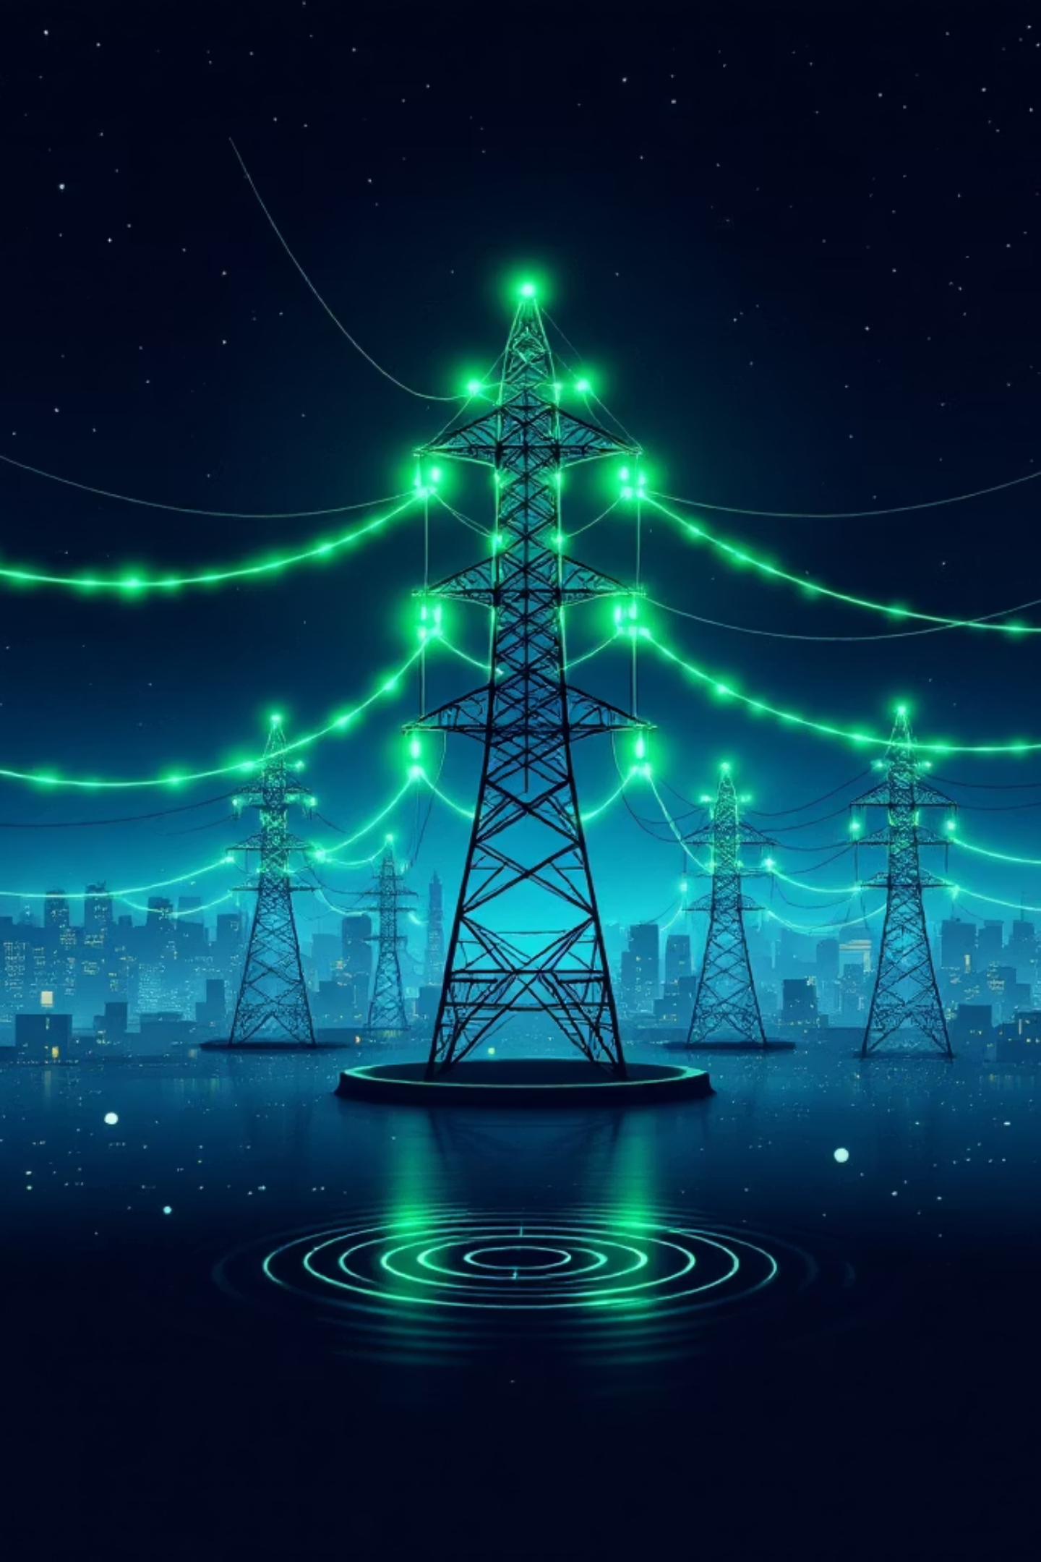
STRATEGIC THREAT INTELLIGENCE
POST-2024 ANALYSIS
Cyber Threat Intelligence & Financial Risk Assessment of the Energy Sector
A comprehensive, data-driven examination of the threat landscape, financial exposure, catastrophic risk scenarios, and evidence-based mitigation strategies facing energy providers, utility operators, and critical infrastructure owners — grounded in 2024 empirical data with forward-looking projections through 2026.

Slide 2
Key Threats & the Top 5 Cyber Attack Vectors
The contemporary threat environment is defined by a paradox: increasing digital connectivity paired with persistent legacy vulnerabilities. In 2025, CISA documented a record surge in ICS advisories, with energy systems accounting for 21.3% of all affected technologies. The following five vectors represent the most consequential risks to the sector.
1
Ransomware & Multi-Stage Extortion
67% of energy and water organizations reported successful attacks in 2024. Backup compromise occurred in 79% of cases, eliminating the primary recovery mechanism and forcing a choice between prolonged downtime and multi-million dollar payments.
2
Nation-State Espionage & Sabotage
State-sponsored actors from Russia, China, and Iran prioritize long-term persistence over immediate gain. Malware families such as TRITON and CRASHOVERRIDE are designed to manipulate physical processes and safety systems, posing a direct threat to human life.
3
Software Supply Chain Compromise
90% of the world's top energy companies experienced breaches from third-party compromises. The 2020 SolarWinds attack demonstrated how a single trojanized update can provide deep access into the Department of Energy and multiple utility networks.
4
Legacy OT/IT Convergence Risks
Decades-old operational technology paired with modern, internet-facing gateways introduces critical security gaps. These legacy systems frequently lack support for modern authentication protocols like MFA, creating exploitable entry points once the corporate perimeter is breached.
5
Malicious & Accidental Insider Threats
In 2024, nearly half of all businesses reported more frequent insider attacks. In the energy sector's high-complexity environment, a single misconfigured firewall or over-privileged account can trigger cascading operational failures.
Critical ICS Vulnerability Patterns
Analysis of the most common weakness types in energy sector ICS products reveals a dangerous concentration in input-handling and memory-safety issues. 82% of all published advisories in 2025 reached high or critical severity, with the average CVSS score climbing toward 8.07. Siemens alone accounted for 55% of total exploited CVEs in the 2024–2025 period.
CWE Identifier
Advisory Count
Operational Risk Implication
CWE-20: Improper Input Validation
73
Key enabler for RCE and protocol manipulation
CWE-125: Out-of-bounds Read
57
Data exfiltration and credential theft from memory
CWE-787: Out-of-bounds Write
57
System crashes and unauthorized code execution
CWE-121: Stack-based Buffer Overflow
42
High-severity exploits targeting controller firmware
CWE-22: Path Traversal
37
Unauthorized access to sensitive configuration files

Slide 3
Financial Impact of Cyber Incidents
The financial repercussions of cyberattacks in the energy sector are disproportionately high compared to broader industry averages. The "high-availability" requirement of energy services and the catastrophic cost of operational downtime place this sector in third place globally for breach costs, surpassed only by healthcare and finance.
$5.56M
$3.0M
199
$125K
Avg. Breach Cost
Median Recovery
Days to Identify
Per Hour Downtime
Industrial sector, 2024 — an 18% YoY increase
Energy/water ransomware — 4x increase in one year
Average breach identification dwell time for industrial sector
Unplanned outage cost for power generation facilities
Cost Breakdown by Category
Detection & Escalation
Post-Breach Response
Operational Downtime
Regulatory Penalties
Forensic investigations, crisis management, and third-party security engagement. Industrial sector identification time averages 199 days — 5 days longer than the global mean.
Customer support, credit monitoring, and public relations costs combined with lost business revenue total an average of USD 2.8 million per incident in 2024.
Recovery is complicated by the need to manually restore OT systems, which cannot be simply rebooted from cloud backups without risking physical equipment damage.
NERC CIP enforcement fines can reach USD 1 million per day per violation. Historical peaks have reached USD 10 million for systemic non-compliance.
Comparative Financial Metrics: Energy vs. Global
Metric
Energy/Industrial (2024)
Global Average
Average Total Breach Cost
USD 5.56 Million
USD 4.88 Million
Median Ransomware Recovery
USD 3.0 Million
USD 0.75 Million
Median Ransom Payment
USD 2.5 Million
USD 2.0 Million
Identification Dwell Time
199 Days
194 Days
Containment Time
73 Days
64 Days
The quadrupling of recovery costs for energy and water utilities — from less than USD 1 million to USD 3 million in a single year — is the most critical financial signal of 2024. This surge is driven by the deliberate targeting of the sector by high-capability ransomware groups who understand that utilities are acutely sensitive to service interruptions.

Slide 4

Catastrophic Risk: The Erebos Scenario
Beyond individual breaches, the energy sector must account for "black swan" events capable of crippling the bulk power system of a major nation. The Erebos scenario, modeled in the Lloyd's "Business Blackout" research, provides a sobering assessment of systemic fragility in modern power grids.
Scenario Parameters
Long-Term Financial Consequences
A sophisticated malware-based attack targets the Northeastern U.S. power grid, infecting control rooms and causing physical damage to 50 critical generators. The malware forces generators to overload and burn out, leading to fires and explosions that physically destroy high-value assets.
Scenario
GDP Loss
Insurance Claims
Standard (S1)
USD 243 Billion
USD 21.4 Billion
93 Million
Weeks-Long
Extreme (X1)
USD 1+ Trillion
USD 71.1 Billion
People affected across 15 states and Washington, D.C.
Blackout duration in high-demand regions like NYC
In the extreme version, wholesale and retail trade would suffer an estimated USD 52.51 billion loss. Macroeconomic analysis indicates a 0.61% quarterly shock to U.S. GDP, requiring up to three years to return to pre-shock equilibrium. This underscores the systemic risk the energy sector's cybersecurity posture poses to the broader financial system and global credit ratings.
The cascade triggers societal breakdown: electric pump failures disrupt water supplies, transit networks collapse with stranded subways, and mortality rates climb as health and safety systems fail.

Slide 5
Case Study: Colonial Pipeline Ransomware Incident (2021)
The Colonial Pipeline attack is the definitive case study in how a breach in IT systems can force a complete shutdown of OT operations due to the interconnected nature of modern critical infrastructure.
Attack Profile
Operational Timeline
The DarkSide ransomware group gained access through a legacy VPN account using a single compromised password — without Multi-Factor Authentication enabled. Once inside, the attackers exfiltrated 100 GB of data in just two hours before deploying ransomware that encrypted billing and accounting systems.
May 7, 2021
Pipeline shut down. Panic buying triggers East Coast gas shortages across multiple states.
Financial Impact
May 12, 2021
Colonial paid a ransom of 75 Bitcoin (USD 4.4 million). The DOJ later recovered USD 2.3 million. The company faced substantial additional costs: business interruption losses, remediation investments, and long-term reputational damage to stakeholder confidence.
Systems begin limited restart after ransom payment and partial DOJ recovery.
May 15, 2021
Normal operations resume after 8-day disruption to 45% of East Coast fuel supply.
Key Lessons for the Sector
MFA Is Mandatory
IT/OT Interdependency
Backup Integrity
A single password without MFA enabled the entire breach. This control is not optional for critical infrastructure.
The inability to process bills on the IT side effectively halted the physical flow of oil — proving that business systems and operational systems are inseparable.
Rapid data exfiltration and encryption underscore the need for immutable, air-gapped backups that cannot be reached through compromised networks.

Slide 6
Evidence-Based Mitigation Strategies
The defense of energy infrastructure demands a shift from compliance-centric security to risk-centric resilience. Organizations using security AI and automation extensively in 2024 saw breach lifecycles 80 days shorter and costs USD 1.88 million lower than those without such tools.
Implementation Metrics & ROI of Security Controls
Strategy
Effectiveness
Est. Cost
ROI / Value Metric
Microsegmentation
80% reduction in lateral movement
15–20% of security budget
USD 3.50 value per USD 1 spent
Phishing-Resistant MFA
Prevents 80–95% of credential breaches
Moderate / SaaS-based
Avoids USD 4.4M+ ransom scenarios
AI/Automation in SOC
Reduces breach costs by USD 2.2M
USD 30K platform + staffing
4x to 10x ROI in incident prevention
Zero Trust Architecture
57% reduction in breach risk
High (multi-year program)
15x faster recovery (MTTR)
Immutable Backups
100% data loss prevention from encryption
Scales with data volume
Eliminates ransom payment necessity
Energy-Specific Dual-Framework Approach
NERC CIP — Regulatory Floor
ISA/IEC 62443 — Technical Design
The NERC Critical Infrastructure Protection standards provide the mandatory legal baseline for the North American bulk electric system. Key standards include:
International standards for ICS lifecycle security, requiring "Zones and Conduits" architecture. Security Levels define the threat actor profile defended against:
CIP-002: Categorization of critical BES Cyber Assets by impact level
CIP-005: Electronic security perimeters with restricted access controls
CIP-007: Systems security — port management, patching, malware prevention
CIP-014: Physical security of substations and generation facilities
SL1: Casual or accidental violation (basic hygiene)
SL2: Intentional violation using simple means
SL3: Sophisticated targeted attacks (hackers)
SL4: Advanced means with extended resources (nation-states)
Critical control systems should target SL3 or SL4.
Strategic Imperative for 2026: The transition from "security through air-gapping" to "security through Zero Trust" is no longer optional — it is a prerequisite for operational survival. The sector must pursue IT/OT integrated visibility, autonomous response capabilities, and engineered resilience to ensure uninterrupted power delivery in the face of escalating threats.

